Slide 1
Deirdre Gouta Mmolotsa (BIDA22-068),Reneilwe Keoagile (BIDA22-061),Letso Manyanda (BIDA22-062),Loago Junior Rantao (BIDA22-064)
OPTIMISING RETAIL OPERATIONS USING DATA ANALYTICS TO GAIN A COMPETETIVE ADVANTAGE AND INCREASE SALES FOR WALMART INC

Slide 2
INTRODUCTION
The rise of e-commerce, globalization and evolving market conditions complicate the retail environment which necessitates a shift to modern data driven methodologies.
Challenge of traditional retail management techniques which relied heavily on intuition is insufficient in the current era.
Walmart specifically faces challenges in managing supply chains, setting competitive prices and providing personalized customer experiences.
The objective of this initiative is to use data analytics to optimize Walmart Inc’s retail operations by offering practical insights that improve productivity, effectiveness and overall performance across a range of departments..
This project underscores the significance of data-driven strategies in transforming retail operations.
To address these challenges, the project focuses on data analytics approaches. The use of exploratory data analysis and the implementation of linear regression helps to improve efficiency, drive sales and maintain Walmart’s competitive edge in the retail industry.

Slide 3
AIMS AND OBJECTIVES
The goal is to offer Walmart Inc. meaningful data analytics insights that it can use to boost profitability and obtain a competitive edge. To verify these findings, the study will also assess the possible advantages and difficulties of putting data analytics into practice.
Objectives:
Conduct Literature review
Data Collection and Preparation
Exploratory Data Analysis
Predictive Modelling Development
Implementation Strategy Formulation
Framework Development
Framework Validation
Documentation and Knowledge Transfer

Slide 4
METHODOLOGY
The project's methodology focuses on optimizing retail operations using secondary data sourced from Kaggle, (WalmartSalesData.csv dataset).
Secondary data analysis provides a cost-effective and time-efficient method for obtaining relevant data.
Several stages: data collection and preparation, exploratory data analysis (EDA), predictive modelling development, implementation strategy formulation, framework development, framework validation, and documentation and knowledge transfer.
Quantitative and qualitative data analysis techniques used to analyse the dataset, which includes variables related to sales transactions, customer demographics, store layout, and inventory levels.
.

Slide 5
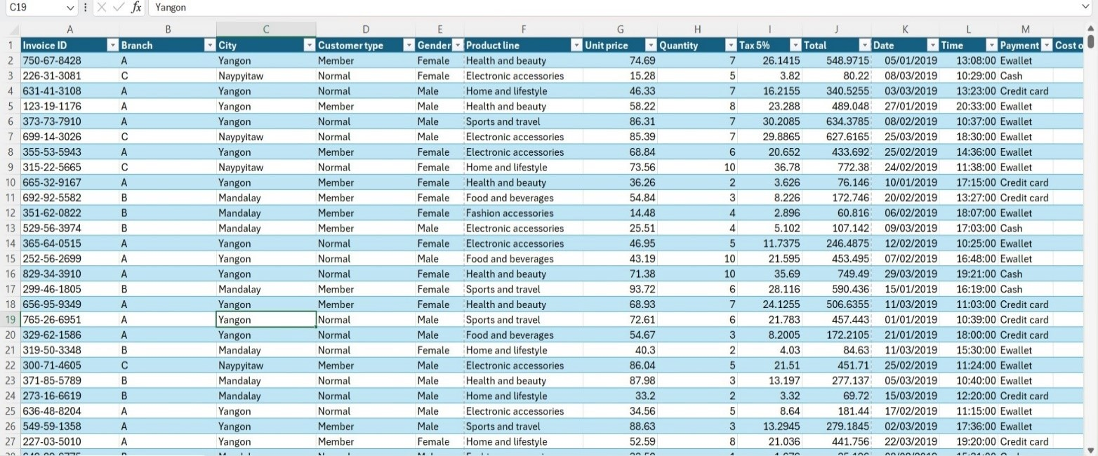
RESULTS (EDA)
Objective
By analyzing key areas such as total sales, customer segmentation, product lines, and pricing strategies, we aim to uncover actionable insights.
Data cleaning and preparation( dataset overview, data cleaning and a screenshot of cleaned dataset )

Slide 6
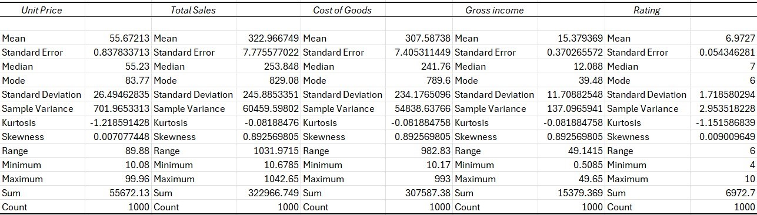
RESULTS (EDA)
Descriptive statistics summary- unit price, cost of goods sold, gross income and rating

Slide 7
RESULTS (EDA)
Objective (OPEN POWER BI TO SEE DASHBOARD)
Identify patterns, trends, and actionable insights through visual analysis
Sales Trends: Identified periods of growth and anomalies.
Branch/Product Line Performance: Variations in sales; strengths and areas needing improvement.
Customer Segmentation: Member vs. Non-member sales insights.
Pricing Strategies: Variations and customer satisfaction correlation.
Cost-Effectiveness: Branch-specific insights.

Slide 8
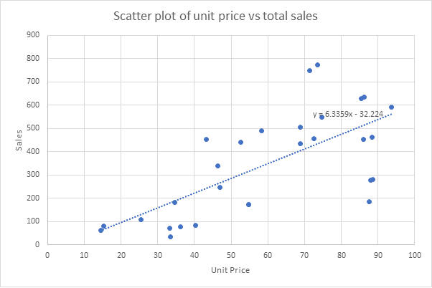
RESULTS
Linear regression was used to analyze the relationship between unit price, cost of goods sold (COGS), quantity, and total sales revenue. The analysis provided insights into pricing strategies, inventory management, and sales performance.
Unit price vs total sale scatter plot
Positive Relationship: There is a positive relationship between unit price and total sales revenue.
Regression Equation: y = 6.3359x - 32.224
R Squared: 0.513846148
Adjusted R Squared: 0.476449698
Correlation Coefficient: 0.716830627

Slide 9
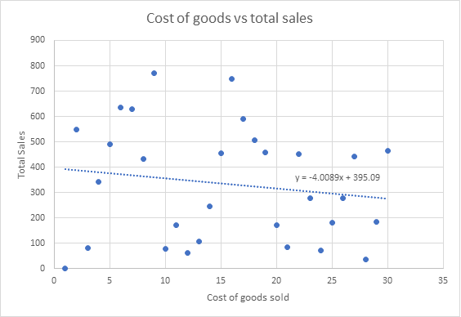
RESULTS
COGS vs total sale scatter plot
Negative Relationship: There is a negative relationship between cost of goods sold and total sales revenue.
Regression Equation: y = -4.0089x + 395.09
R Squared: 1
Adjusted R Squared: 1
Correlation Coefficient: 1

Slide 10
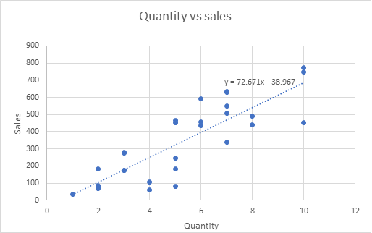
RESULTS
Quantity vs total sale scatter plot
Positive Relationship: There is a positive relationship between quantity and total sales revenue.
Regression Equation: y = 72.671x – 38.967
R Squared: 0.707106
Adjusted R Squared: 0.684576
Correlation Coefficient: 0.840896

Slide 11
DISCUSSION OF FINDINGS
Dynamic Pricing Strategy: Increased revenue through price adjustments on the e-commerce platform, based on positive correlation between unit price and sales.
Cost Management: Enhanced profit margins by reducing cost of Goods Sold through economies of scale and efficient supply chain management.
Improved store layout: Higher sales better inventory turnover by optimizing shelf space, product placement, and reducing congestion in stores.
Customer Feedback Enhancement: Better identification of improvement areas through enhanced data collection and analysis of customer reviews, leading to increased customer satisfaction.
Bulk Sales and Inventory Planning: Increased sales by maintaining higher inventory levels for popular products frequently purchased in bulk.
Strategic Pricing and Product Focus: Higher overall sales by identifying and strategically pricing Key-Value items(KVIs), especially in top-performing product lines like Health and Beauty.

Slide 12
CONCLUSIONS, RECOMMENDATIONS AND FUTURE WORK
Conclusions:
Unit price positively affects total sales.
Higher COGS reduces sales.
Weak link between ratings and sales.
Higher quantity sold boosts sales.
Health & Beauty leads in sales.
Recommendations:
Implement dynamic pricing.
Optimize COGS and store layouts.
Improve feedback for ratings.
Maintain inventory for bulk items.
Identify and price key-value items.
Future work:
Use a larger, annual dataset.
Conduct experimental technology trials.
Ensure access to detailed metadata.
Study seasonal sales trends.

